Slide 1
EXPLORATORY DATA ANALYSIS
IDS ASSIGNMENT-1
Chocolate Bar Ratings
Expert ratings of over 1,700 chocolate bars

Slide 2
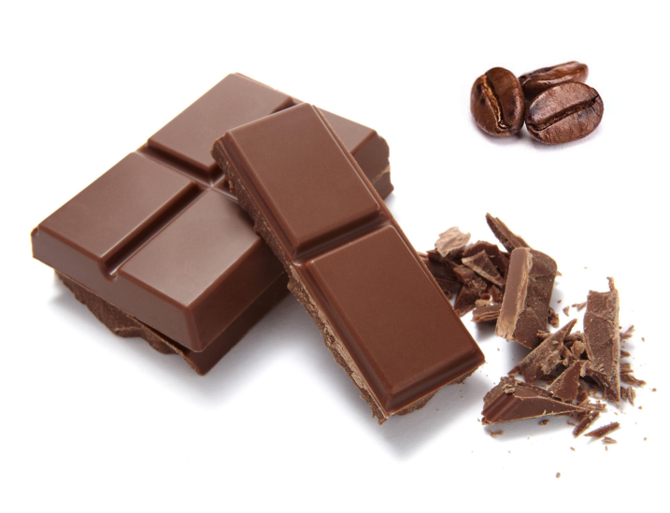
Dataset contains the following columns:
Company
Specific Bean Origin
REF
Review Date
Cocoa Percent
Company Location
Rating
Bean Type
Broad Bean Origin

Slide 3


Data Cleaning
Cleaning of the BroadBeanOrigin column
Cleaning of BeanType column

Slide 4
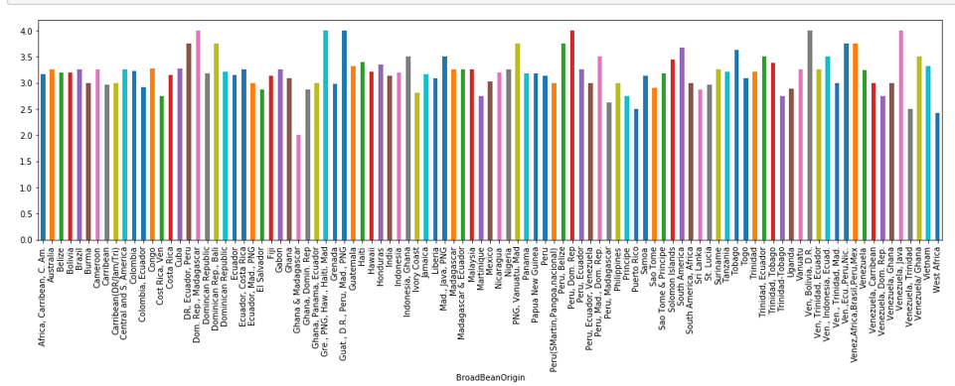
Broad Bean Origin vs Rating
Best cocoa beans grown:
Dominican Republic, Madagascar, Venezuela, and blends of beans from these places.

Slide 5
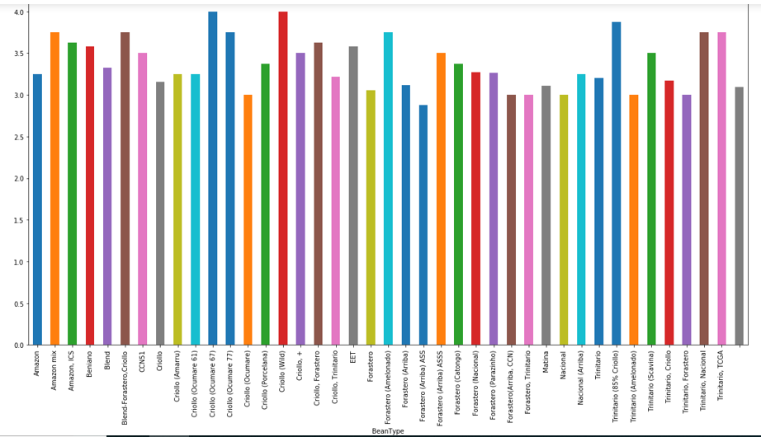
Bean Type vs Rating
Criollo(wild) and Criollo(ocumare 67) are the bean types that have the best rating.

Slide 6

Cocoa Percent vs Rating
Most bars have cocoa percents between 50 and 90.
The highest rated have about 70% cocoa.
In general, the highest ratings are for bars with 60- 70% cocoa.

Slide 7
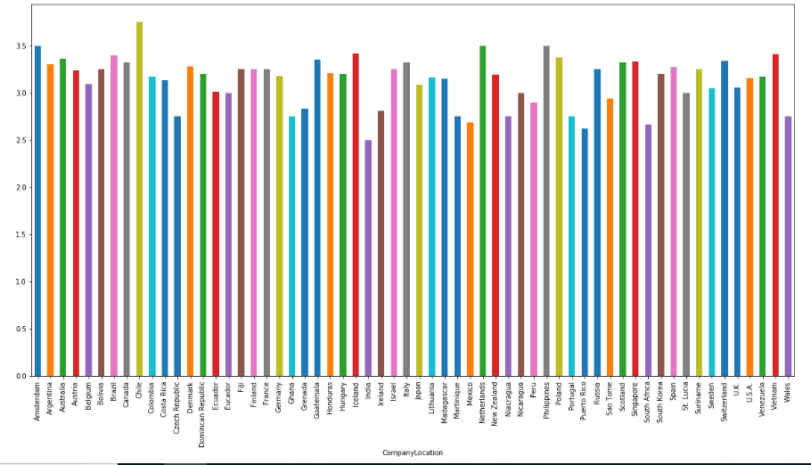
Company Location vs Rating
Chile has the highest rating while India has the least rating.

Slide 8

Place of Chocolate Companies
print(df.groupby("CompanyLocation")['Rating'].mean())
From this, we see that
Average Rating = 3.15
Average Rating of highest(Chile) = 3.75
U.S.A. is most frequent, but average is lower than a lot of averages. Companies probably set up here because of the better business prospects.

Slide 9
Which areas produce the highest rated chocolate bars?
Chile. The average rating is 3.75. Criollo beans are used, and they originate from Peru.
The next highest, in no particular order, are Amsterdam, the Netherlands, and Vietnam. This might be related to the amount of cocoa the company in these areas use.
For instance, the average cocoa percent in bars made in Chile is 70%, which seems to be ideal. Amsterdam, the Netherlands and Philippines use quantities that make up a little more than 70% of the chocolate.
India produces the lowest rated bars.

Slide 10

Specific Bean Type vs Rating for the most frequently occurring company
Cedeno, lot 271 and Madagascar are the specific bean origins used by twenty-four blackbirds which is the most frequently occurring company while Palos Blancos has least rating.

Slide 11
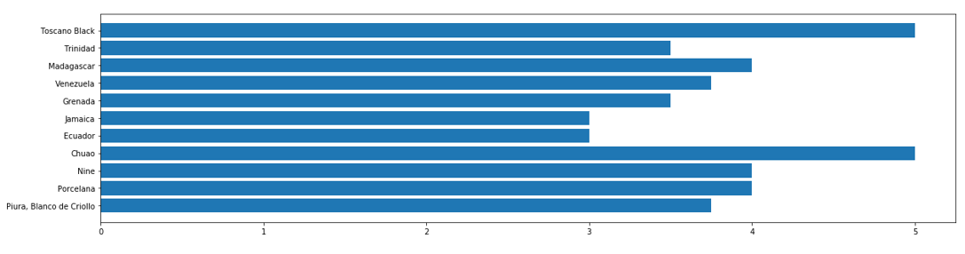
Specific Bean Origin vs Rating for the company with highest ratings average
Chuao and Toscano Black have highest ratings while Jamaica and Ecuador have least ratings for Amedei, the company with highest ratings average

Slide 12
Data Analysis Summary :
Best cocoa beans grown
Relationship between cocoa solids percentage and rating
Areas that produce the highest rated chocolate bars
Company that produces the highest rated chocolate bars
Place where most companies manufacture chocolate bars.
Company location that has highest and least ratings
Relationship between bean type and rating
Relationship between specific bean type and rating for the highest rated company

Slide 13
SHAMITHA K
PES1201700973
BAGYASREE S
PES1201700164
SECTION – E

